Slide 1
Teachers’ struggle of Sri Lanka
Sri Lanka is an island with 22 million population.
Ex colonial country of Britain.
Nearly 240,000 teachers work in Government schools.
16,000 Principals manage the schools.
There are 10,165 government owned schools in the country.
365 schools are run by the central government and others are run by Nine Provincial councils. They are popular and well facilitated schools.

Slide 2
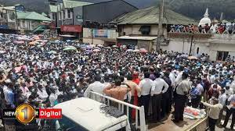
Teachers’ protests

Slide 3
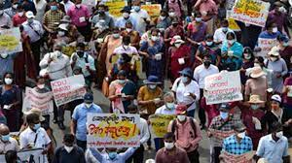
Teacher’ March from Kandy to Colombo

Slide 4
The recent history of teachers’ struggle
Due to covid 19 pandemic, All schools have been closed since 2020.
Teachers have started to teach students via online. But the government does not have any plan to proceed the education.
A leading teachers’ trade union leader had been arrested by the police on 10th of July this year and sent to a quarantine Centre forcefully.
Teachers had decided to call off the online teaching and came to street massively.

Slide 5
Teachers’ protests spread throughout the country
Teachers urge the union leaders to put forward the long standing salary anomalies problem at the struggle.
Obviously this problem created 24 years ago.
In 1995, teachers had been received a salary which similar to Sri Lanka Education Administrative service.
But in 1997 this salary had been cut and dropped into a lower scale.
At present, an education administrative officer gets a salary of $380/- monthly.

Slide 6
A Grade one teacher gets only a salary of $225 monthly.
The salary difference is $155.
A Graduate teacher’s starting salary is $ 165.
An ordinary graduate teacher earns $ 5.3 daily.
Teachers are the people who get lowest salary in Sri Lanka.

Slide 7
The teachers’ struggle lasts for 84 days now.
Majority of teachers have joined to the struggle.
Our trade union consists of 4000 membership now.
The major teacher trade union is still represented with 45000 teachers.
50% of teachers do not represent any trade union.
There are nine province in Sri Lanka and we as Ceylon Independence Teachers’ service union represents in three province with a considerable membership.
We are being spread into another three provinces at present.

Slide 8
Now We are discussing to form a Teachers’ Trade Union Confederation
Thank you!

